Slide 1

OMBD and the Oscars
Jiaolu Xie, Uwagboe Olusoga, Erik Scribner

Slide 2
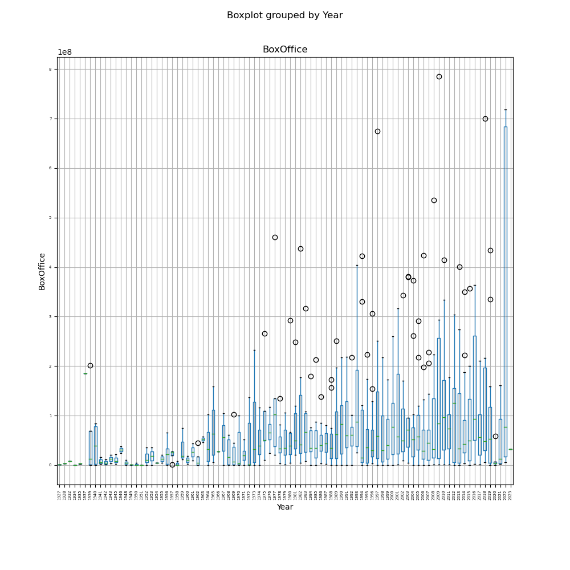
Xiaolu – Data cleaning and box office analysis

Slide 3
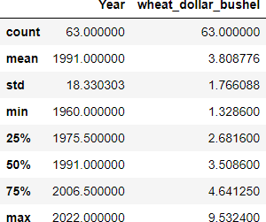
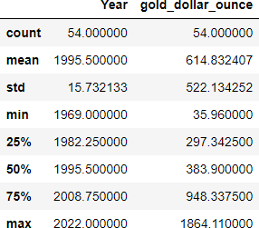
Xiaolu – Data cleaning and box office analysis

Slide 4
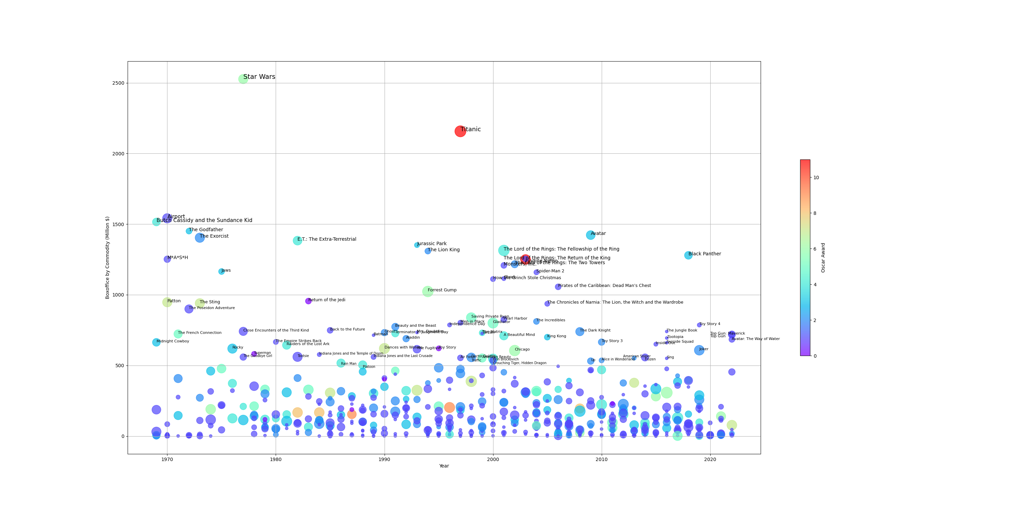

Slide 5
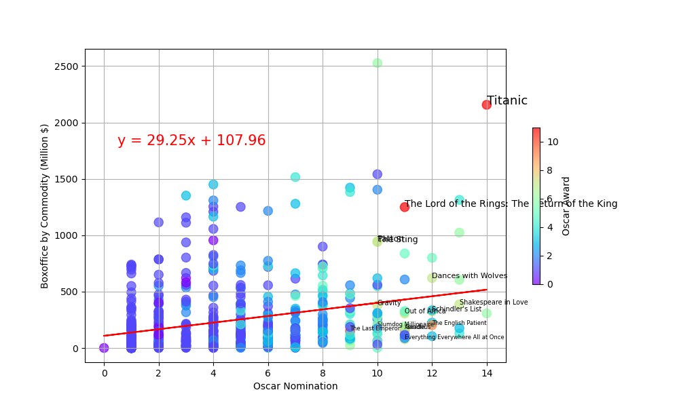
Regression of Nomination vs Commodity Box Office

Slide 6
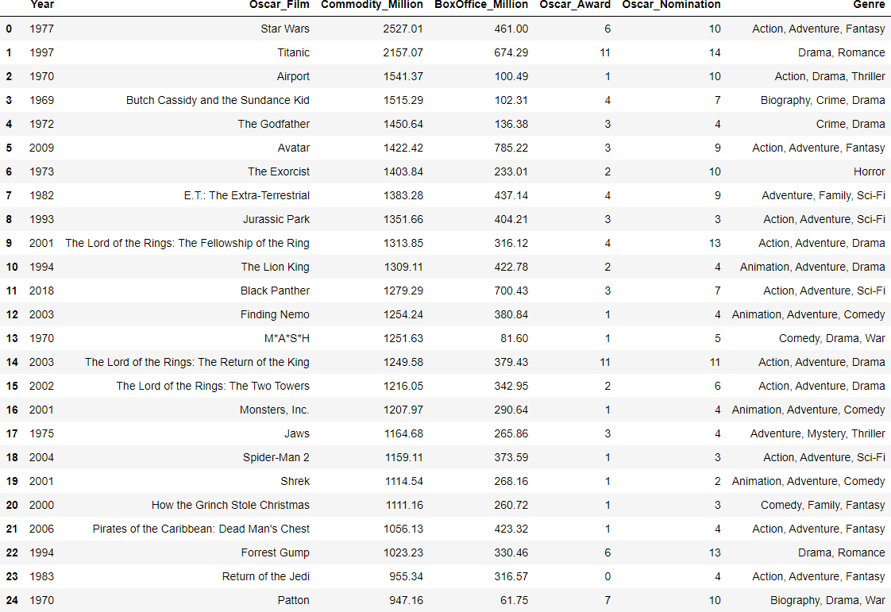
6

Slide 7
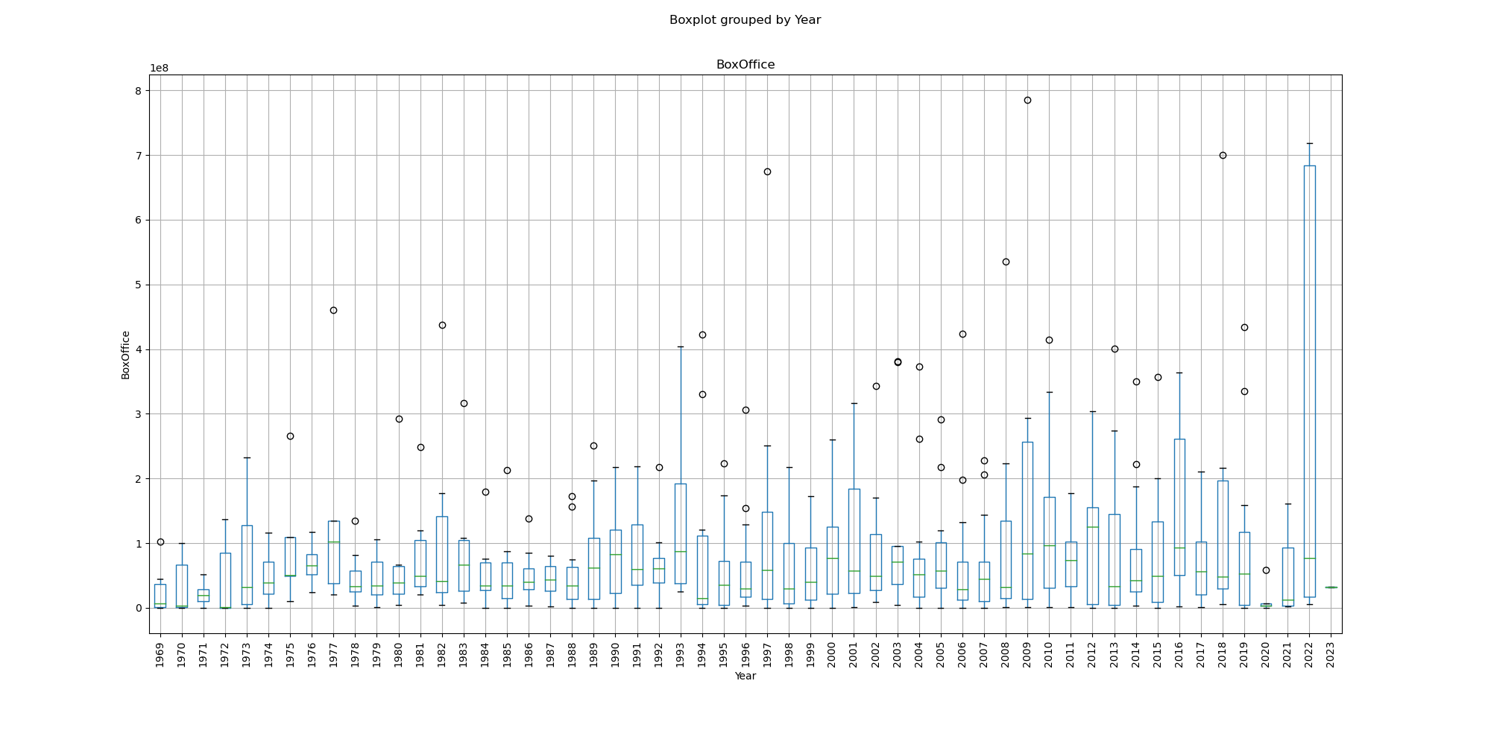
UWAGBOE – COMMODITIES AND BOX OFFICE ANALYSIS

Slide 8
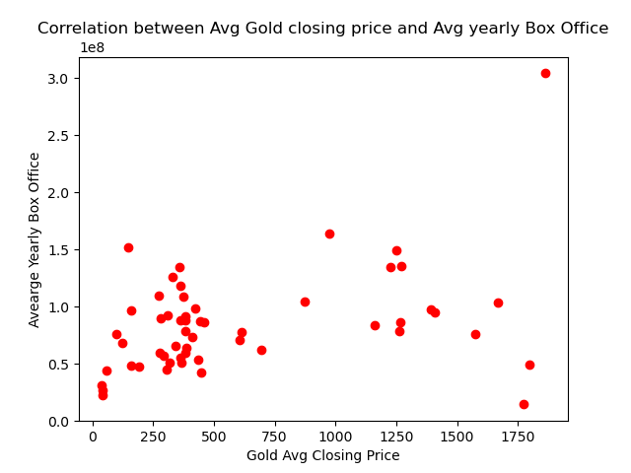
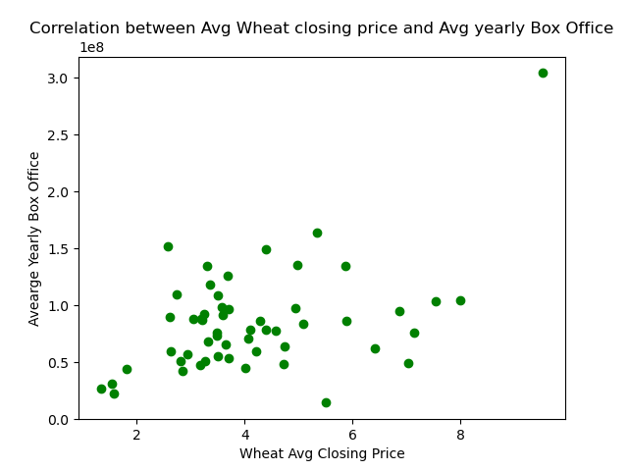

Slide 9
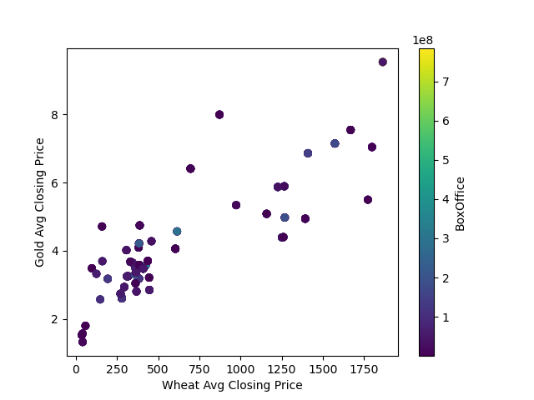

Slide 10
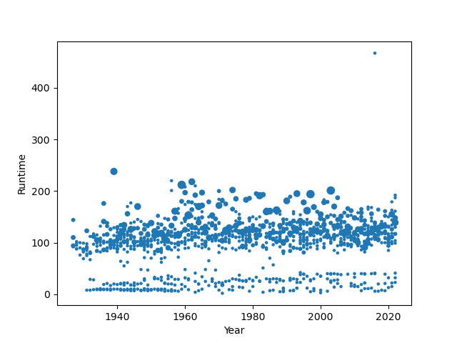
ERIK – RUNTIMES VS AWARDS
Oscars Won, by Year and Runtime

Slide 11
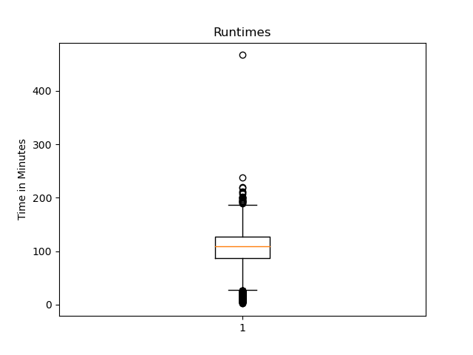
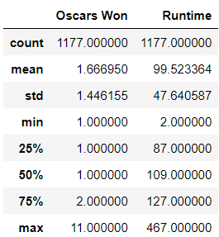

Slide 12
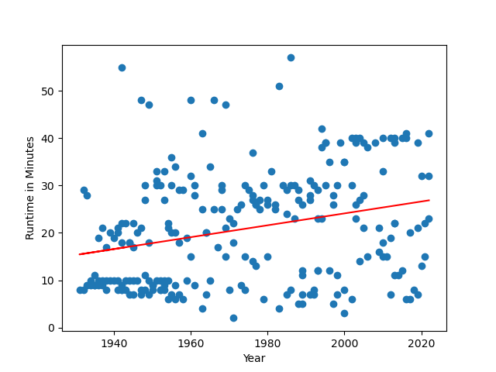
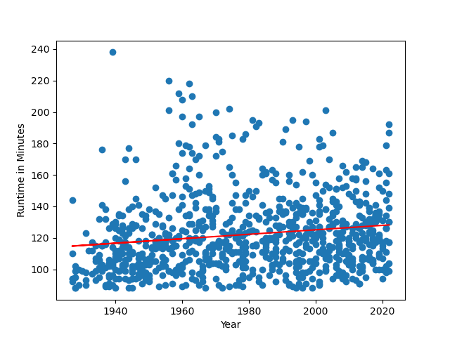
Shorts
Features

Slide 13
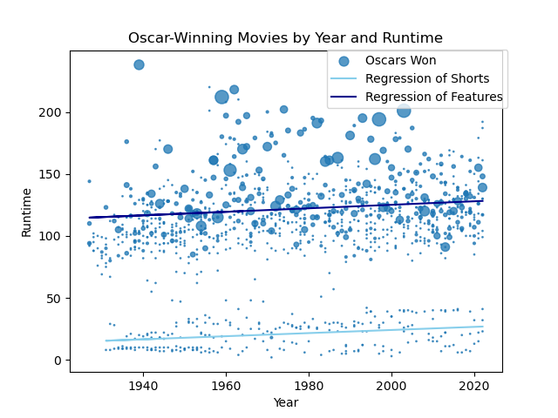

Slide 14


